Slide 1
Developing DotNetNuke 6 Modules
Ian Robinson
Sr. Software Engineer
DotNetNuke Corporation

Slide 2
House Keeping
Breaks
10:30 & 2:30 (15 Min)
Lunch
12:00 – 1:00
Questions

Slide 3

About Me / Resources
Twitter @irobinson
GitHub http://github.com/irobinson
Professional Profile: http://bit.ly/irobinson
Email: ian@dnncorp.com

Slide 4
Agenda
Crash Course: DotNetNuke Module Development
High level tour. Key concerns, strategies and techniques.
Deep Dive: WebFormsMVP
How and why? Unit testing! Diving into code.
Introducing: Client Resource Management
Key concepts and strategies for working with JS and CSS

Slide 5
Section 1 DotNetNuke Module Development Crash Course

Slide 6
Section 1
DotNetNuke Module Development
Roles
Goals
How DNN Works
Bare minimum configuration
Project Structuring
Development styles
Key API Methods
Form patterns & jQuery plugins

Slide 7
The Spectrum of Roles
Savvy Hobbyist
Developing in their free time, maybe pro-bono work, etc
Small biz
The “how many hats can I wear at once?” developer.
Big biz
Focused on building modules
Consultant/integrator
Builds solutions for clients
Commercial Module Developer
Sells modules on the interwebs

Slide 8
The Goals of Module Developers
Develop “stand-alone” code, make it show up in DNN
Learn how to plug code in to DNN
What are the bare minimum requirements to get going?
Tight integration with DNN features
Leverage the API, get to know how DNN works
Learn UI and functional paradigms

Slide 9
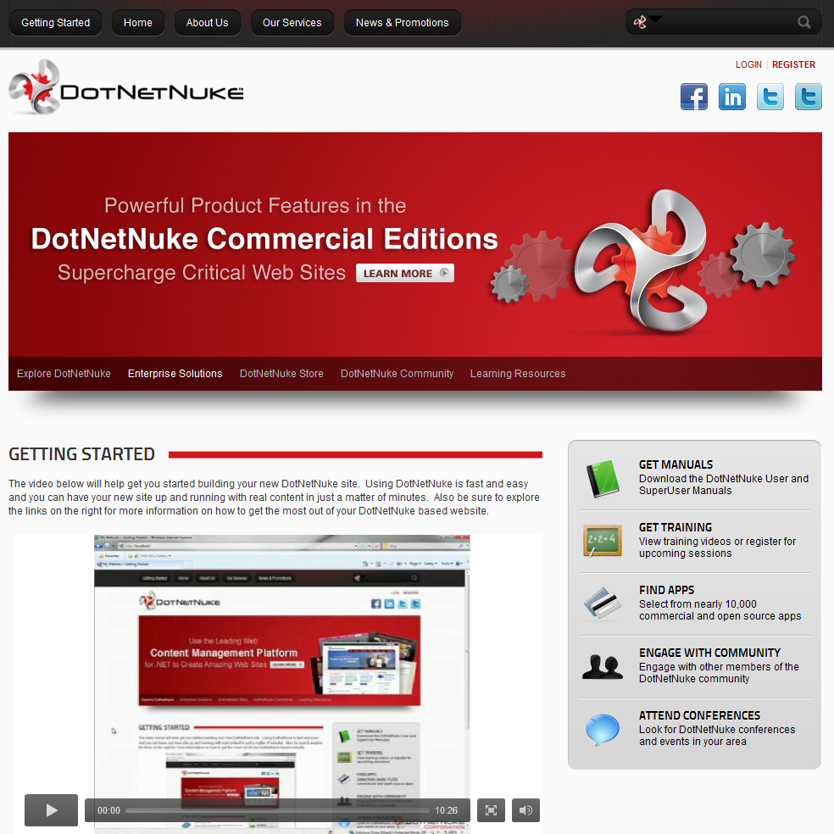
So, how does DNN work?
Default.aspx
User controls
Within user controls
Within user controls
Notes:
Go over to DNN, show user controls within user control within user controls within user controls within user controls within user controls within user controls within user controls within user controls within user controls within user controls within user controls within user controls within user controls within user controls….

Slide 10
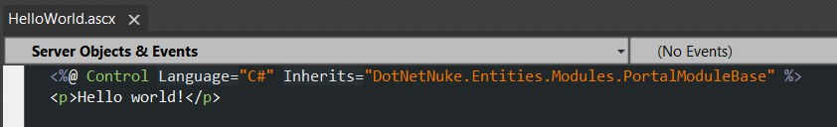
The Bare Minimum Module
One user control
Place in a folder within DesktopModules
Inherit from common base class
PortalModuleBase
Register module through Host -> Extension
Notes:
Demonstrate the bare minimum module in action.

Slide 11
Development Styles & Strategies
Environment choice + development strategy
Razor Modules
Inline Script
ASP.NET Web Site Project (WSP)
ASP.NET Web Application Project (WAP)
WebFormsMVP (Using WAP)

Slide 12
Some things to keep in mind…
Project Size
Team Size
Team Experience
Business Urgency
Problem Complexity

Slide 13
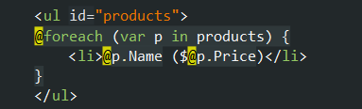
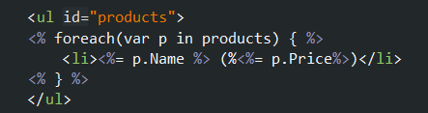
Razor Modules
First, what is Razor?
Code-focused templating
HTML Generation
MVC View Engine
Razor:
ASPX:

Slide 14

Razor Modules
Razor in DNN
Razor Host Module
DNN context available
Packaging/ASCX Buddy System
Reference: Razor’s Edge User Map

Slide 15
Inline Scripting
Quick and easy
Dynamically compiled
Well known for average .NET developer
Main benefit: All code in ASCX files
Reference: Customer Feedback Module

Slide 16
VS Web Site Projects
Integrates into App_Code and DesktopModules
Main benefit: dynamically compiled
More organization + scales better than inline script
Reference: IWeb

Slide 17
VS Web Application Projects
WAP is just the project environment
The strategy is generally larger scale, Object Oriented, n-tier development, etc.
File system/Project in DesktopModules
Build to /bin
Include own assemblies
References: DnnSimpleArticle

Slide 18
WebFormsMVP
Demo: coming up!
Project environment is the same as a WAP
Strategy is leveraging the MVP pattern

Slide 19
Key DNN API
Current Context
Localization
Navigation
Module Settings

Slide 20
Current Context
Portal
What portal am I in?
Page
What page am I on?
User
Who is the current user (if logged in)?
Module
What settings do I have?

Slide 21
Localization
Resource Files / Keys
Local Resource File
Convention based discovery
Declarative
In markup
ResourceKey=“”
Imperative
In code
LocalizeString(“”)
Localization.GetString(“”, this.LocalResourceFile)

Slide 22
Module Registration
Control Types
View
Primary type for public facing module views
Edit
Focus
Settings
Integrate with “out of the box” module settings
Manifest Files
XML files defines key points
Useful for packaging and installation

Slide 23
Navigation
NavigateURL()
Returns the URL of the default view control for your module
NavigateURL(TabID)
Returns the URL of the specific tab
NavigateURL(TabID, String.Empty, “itemId=4”, “mode=2”)
Returns the target tab URL with custom parameters
Tab == Page

Slide 24
Navigation
EditUrl
Helps you to navigate to a specific control
Specify by key used during registration
Module Isolation
Tab == Page

Slide 25
Module Settings
All modules have settings
Custom Module settings
Build your own settings control
Settings base class
Two key methods (Load and Save)
Register appropriately
Module Settings
Tab Module Settings

Slide 26
General UI Guidelines
User-facing UI is pretty open ended
Be a good DNN citizen
Semantic well-structured markup (paragraphs, lists, etc)
Common sense look and feel
You’re not a designer, so keep it simple
Setting different font-sizes? Sure…
Setting different type-faces? Not so much…

Slide 27
Admin User Interface
DNN Admin UI Patterns
Allow for complete consistency across modules
Take the guesswork out of implementing the UI
Messaging! Info, Success, Error, Warning
Reference: Crispy’s Contest Module

Slide 28
Section 2 Deep Dive: WebFormsMVP

Slide 29
Section 2
WebFormsMVP
Simple and Easy
WebFormsMVP
Unit Testing
Converting DnnSimpleArticle Module
Review the starting module structure
Convert the edit functionality to the MVP pattern
Refactoring existing logic for testability
Review the unit tests

Slide 30
Simple and Easy in Software
Simple
One role or task
Opposite of complex/intertwined
Easy
Close at hand, known, familiar
Often we choose easy, at the expense of simplicity
Simple is objective, easy is relative

Slide 31
Examining your project needs
Quick? Throw-away? Trivial? Low-impact?
Sure, go with what you know: easy.
Project with any kind of longevity or significant importance?
Spend the time up front to make things simpler.
A bug makes it past the type checker, the tests, and then what?

Slide 32
Separation of Concerns
Each piece has focus
One role, task, concept, dimension
Lack of interleaving
Final product has many focused pieces
Rather than few overloaded pieces

Slide 33
WebFormsMVP
Separation of concerns
Increased Testability
“Cleaner Architecture”
Retains productive characteristics of WebForms

Slide 34
The Players
View
Displays UI, has simple behavior
Does not do “heavy lifting”
Model
Holds data, updated by both view and model.
Used to transfer data back and forth
Presenter
Isolated from view
Performs business logic
Ideally, free of hard dependencies

Slide 35
WebFormsMVP Characteristics
Requires the view to give control to Presenter
The view and presenter pass around a model
Interfaces are used to break hard dependencies
This supports unit testing

Slide 36
WebFormsMVP in DNN
View
ModuleView base class
IModuleView interface
Model
Presenter
ModulePresenter base class

Slide 37
Diving in: DnnSimpleArticle
Started as “normal” Web Application Project
ASPX pages with UI logic and some business logic in code behind
“Edit” view converted to WebFormsMVP
More players, each with a more focused role

Slide 38
Unit Testing Benefits ^{[1]}
Facilitates Change
Simplifies integration
Provides Documentation
Design
[1] http://en.wikipedia.org/wiki/Unit_testing
Notes:
Define unit testing and talk about why we’re here talking about unit testing. Why is it a desirable practice in software development? What benefits does it have? Why do we want to incorporate it into DotNetNuke?
Try to put it in practical terms.
Logical errors – most obvious – you want to know if you’re code is wrong.
Perspective? You’re the consumer of what you write. This has some interesting (and positive) implications.
Prove the logic
Discover errors
Get a different perspective and think critically about your code
Force your code into conciseness

Slide 39
What do unit tests test?
Smallest piece of testable software^{[3]}
Logical and/or complex code
Core business logic
High traffic code / mission critical
Or, in TDD: everything!
[3] http://msdn.microsoft.com/en-us/library/aa292197.aspx
Notes:
The primary goal of unit testing is to take the smallest piece of testable software in the application, isolate it from the remainder of the code, and determine whether it behaves exactly as you expect.

Slide 40
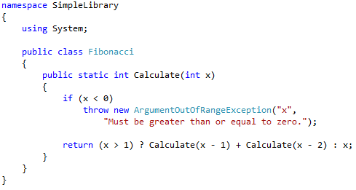
Simple Code

Slide 41
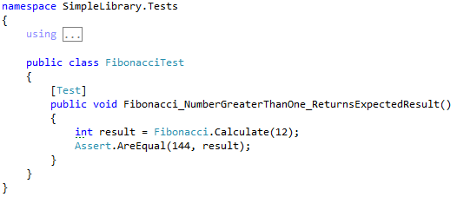
Simple Test

Slide 42

Unit Test Characteristics
Unit tests should be: ^{[2]}
Automated & Repeatable
Easy to implement
Once written, it remains for future use
Anyone should be able to run it
It should run at the push of a button
Run quickly
[2] The Art of Unit Testing, Roy Osherove, Manning Publications 2009
Notes:
Introduce the book and use it to frame the conversation regarding the characteristics of unit tests. Let the audience know what type of additional information can be found in the book.

Slide 43
Testing Frameworks
Unit Testing “Glue”
(Addresses the Automated & Repeatable)
csUnit, MbUnit, MSTest, Nunit, xUnit
Pick one and go

Slide 44
We use MBUnit & Gallio
MbUnit
Class and Method Attributes
Assertions
Gallio Test Runner
Displays results
Visual Studio Integration
ReSharper Integration

Slide 45
What is testable code?
Is all code testable?
Single Responsibility/Separation of Concerns
Dealing with dependencies
Notes:
Need links to resources

Slide 46
Seams
“…place where you can alter behavior of your program without editing it in that place” – (Feathers, 2005)
Plug-in / Injection

Slide 47
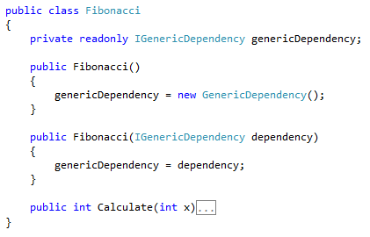
Seam / Constructor Injection

Slide 48
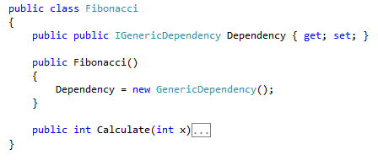
Seam / Property Injection

Slide 49
Two Consumers
Production Code
Tests
Seams help cater to the test

Slide 50
Fakes!
Stubs
Return results
Throw exceptions
Mocks
Verify behavior

Slide 51
Isolation Frameworks
Help us create fakes
And verify expectations
Moq, Nmock, Rhino Mocks, Typemock Isolator

Slide 52
My Setup
MBUnit – Unit testing framework
MOQ – Isolation framework
Gallio – Test runner
Integrated into Visual Studio / Resharper
Notes:
Need to explain tools in general, and then these in particular.

Slide 53
Unit Testing: Quick Summary
Unit testing increases confidence in your code. Code is more changeable.
Therefore Unit Testing is a desirable practice
WebFormsMVP allows us to better conduct unit testing in DotNetNuke

Slide 54
Section 3 Introducing: Client Resource Management

Slide 55
Section 3
Client Resource Management
Background/overview
Key characteristics
Client Dependency Framework
JavaScript and CSS Registration
Implementation details
A new development approach

Slide 56
Overview
Performance is a feature (an important one)
Fast sites lead to satisfied users
DotNetNuke is largely optimized on the server side, was not so much on the client side

Slide 57
Client Side Performance
80% of the end-user response time is spent on the front-end. Most of this time is tied up in downloading all the components in the page: images, stylesheets, scripts, Flash, etc. Reducing the number of components in turn reduces the number of HTTP requests required to render the page. This is the key to faster pages.
-Yahoo! Exceptional Performance Team

Slide 58
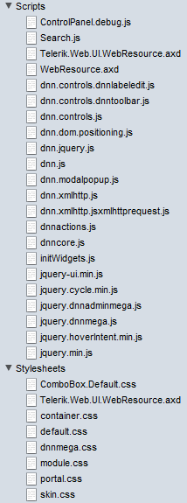
DotNetNuke 6 – Resources Overview
Clean install, home page
unauthenticated
6 CSS Files
13 JavaScript Files
Logged in as host
8 CSS Files
22 JavaScript Files

Slide 59
Goals for Improvement
Reduce the file size of each resource
Only deliver a resource that is needed
Combine resources into as few as possible

Slide 60
Client Resource Management: Key Characteristics
Resource Registration API
Request a JS or CSS resource be loaded
File combination
Combine all requests of a given type into one file
Caching / Persistence
Cache the combined file / save it to disk
Reuse
Reuse cached files across pages if appropriate
Versioning
Allow for cache busting based on versioning

Slide 61
Client Dependency Framework
Open Source Framework
Microsoft Public License (Ms-PL)
Originally released Early 2010
Supports MVC & WebForms
Used in Umbraco
Meets all key characteristics on the previous slide

Slide 62
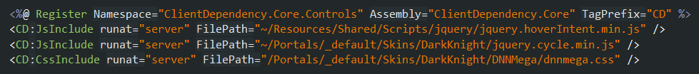
Step 1: Resource Registration
Script Loader on page
Register in code
Or register in markup

Slide 63
Resource Registration w/ DNN API
Wrapped script loader control in Default.aspx
Register in code using DNN API
Or register in markup using wrapped controls

Slide 64
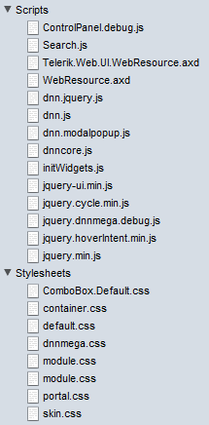
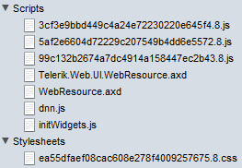
DNN 6.1 w/ Client Dependency
debug=“true”
debug=“false”
Home page, clean install
Unauthenticated
Debug
8 CSS Files
14 JS Files
22 Total
Release
1 CSS Files
7 JS Files
8 Total
14 Fewer Requests

Slide 65
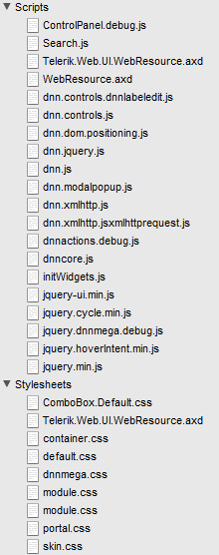
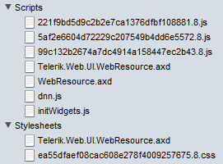
DNN 6.1 w/ Client Dependency
debug=“true”
debug=“false”
Home page, clean install
Logged in as Host
Debug
9 CSS Files
20 JS Files
29 Total
Release
2 CSS Files
7 JS Files
9 Total
20 Fewer Requests

Slide 66
Into the wild
DNN Core Strength: custom & third party components
But, usage means resource requests often grow
Consider these (unauthenticated. As of 8/16/2011)
R2integrated.com: 30+ JS files and 5 CSS files
DataSprings.com: 18 JS files and 11 CSS files
DotNetNuke.com: 16 JS files and 12 CSS files
EngageSoftware.com: 23 JS files and 9 CSS files
Mybrantford.ca: 17 JS files and 9 CSS files
Dreamslider.net: 16 JS files and 9 CSS files

Slide 67
Implementation Details
Reference Assembly
Additional web.config section
Composite files stored in App_Data/ClientDependency
DNN wrapper API methods
RegisterStyleSheet already exists
RegisterScript?
Wrapper control for user in skins and other controls
WebUtility and WebControls assemblies need updating
CDN integration
Load ordering scheme for both JS & CSS

Slide 68
The New API
DotNetNuke.Web.Client Assembly
RegisterStyleSheet methods
RegisterScript methods
DnnCssInclude
DnnJsInclude

Slide 69
File Combination
Duplicates removed based on path/filename
Combined into one file
Absolute external URLS (JS & CSS) such as CDN requests are requested separately
An xml file map is kept on the server
The dynamic URL is a hash of those file path/names

Slide 70
Location in the Document
Provider model
Provider dictates where it is rendered
Out of the box:
LoaderControlProvider
PageHeaderProvider
LazyLoadProvider
DNN Provides:
DnnPageHeaderProvider (6.1.1)
DnnBodyRenderProvider
DnnFormBottomRenderProvider

Slide 71
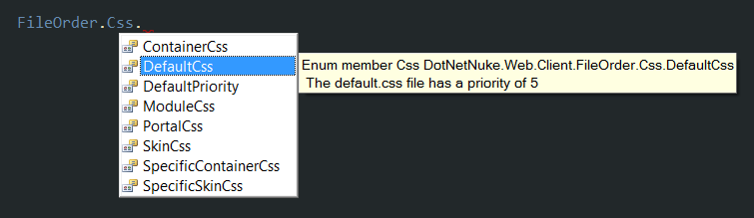
File Ordering
Integer based relative priority
DotNetNuke core file order enumeration (spaced by 5)

Slide 72
Caching and Persistence
ASP.NET Output Caching
MSDN: “On subsequent requests, the page or user control code is not executed; the cached output is used to satisfy the request.”
Stored on disk for persistence across application restarts
Pulled from disk (not rebuilt) and put in cache

Slide 73
Versioning
Integer based version number
Stored in web.config
Forces a fresh rebuild of the files
A variety of ways to increment
Install an extension
Clear the cache
Save Portal.css
Perform an upgrade

Slide 74
Step 2: A New Development Approach
Freed up to structure as necessary
No longer shove all styles into one module.css file
Can break it out into separate files and request as needed
CssInclude(‘base.css’)
CssInclude(‘ui-widgets.css’)
CssInclude(‘gallery.css’)
Same with JS files

Slide 75
Resources

Slide 76
General Module Development
DotNetNuke Wiki (Really!)
jQuery Plugins
Manifest Files
Razor’s Edge User Map
IWeb
DnnSimpleArticle
Customer Feedback
C# WAP Module Development Templates
Updating the Contest Module UI for DNN 6

Slide 77
Simple Made Easy
Rich Hickey, Oct 20, 2011 @ Strange Loop Conference in St. Louis MO. Please watch!!!
http://www.infoq.com/presentations/Simple-Made-Easy

Slide 78
WebFormsMVP Resources
WebFormsMVP.com
DnnSimpleArticle
BeerCollectionMVP
Upcoming: core forums module

Slide 79
Unit Testing Resources
Books
Roy Osherov’s “The Art of Unit Testing”
Michael Feathers “Working Effectively with Legacy Code”

Slide 80
Client Resource Management Resources
ClientDependency Framework on Codeplex
Client Resource Admin Module
DNN Client Resource Logger Library
Blog posts
Enhancements for working with JavaScript and CSS Files in DNN 6.1
DNN 6.1 JS/CSS File Combination Potential Gotchas
Documentation
DNN Client Resource Management API
Client Dependency Framework

Slide 81
Bonus!

Slide 82
Client Capability API
ClientCapabilityProvider
IsMobile
IsTablet
IsTouchScreen
SupportsFlash
+ more
Additional Resources
http://www.dotnetnuke.com/Resources/Blogs/EntryId/3194/Mobile-APIs-in-6-1.aspx
http://www.dotnetnuke.com/Resources/Blogs/EntryId/3208/Mobile-Device-Detection-and-Redirection-ndash-Under-the-Hood.aspx

Slide 83
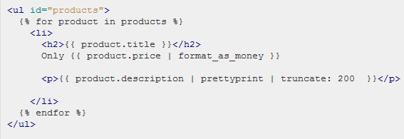
Templating
Ask me about templates!

